Slide 1
Hitler’s Dictatorship
Chancellor -> Fuhrer

Slide 2

From Chancellor to Fuhrer
Hitler becomes Chancellor
The Reichstag Fire
The Enabling Act
Night of the Long Knives
Death of President Hindenburg
Oath of Loyalty to Hitler
DER FUHRER

Slide 3
The Reichstag Fire
The Reichstag burnt down in February 1933
Van de Lubbe (Dutch Communist) was found inside – admitted responsibility
Hitler convinced people that the communists were trying to take power by terrorism
Thus communists banned from Reichstag

Slide 4
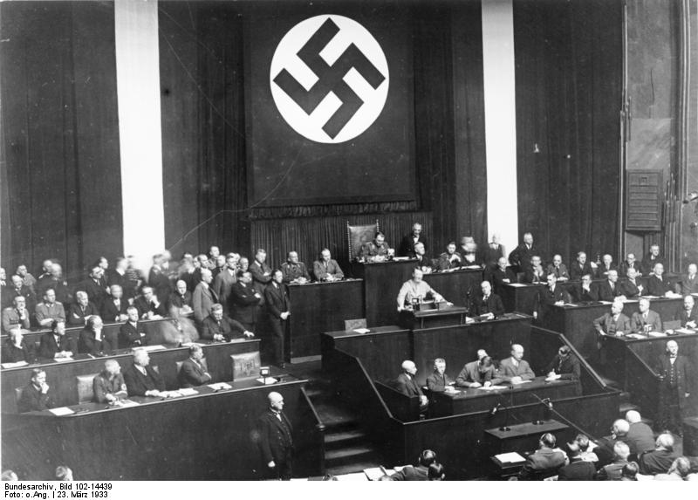
The Enabling Act
March 1933
Communists banned means Hitler can pass the Enabling Act
“Hitler can rule alone for four years. There is no need to consult the Reichstag”

Slide 5
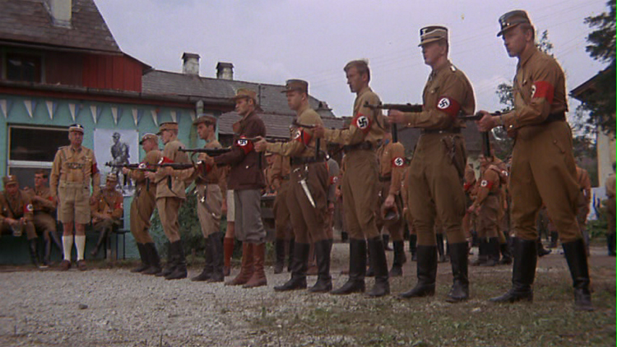
The Enabling Act
Hitler used The Enabling Act to ban all other political parties
Political prisoners were put into concentration camps run by the SS.

Slide 6
Night of the Long Knives
June 1934
Getting rid of internal opposition
Hitler getting rid of Rohm (Leader of SA)
Killed over 400 threats to Hitler’s power
Army were pleased
Hitler gained support of the army

Slide 7
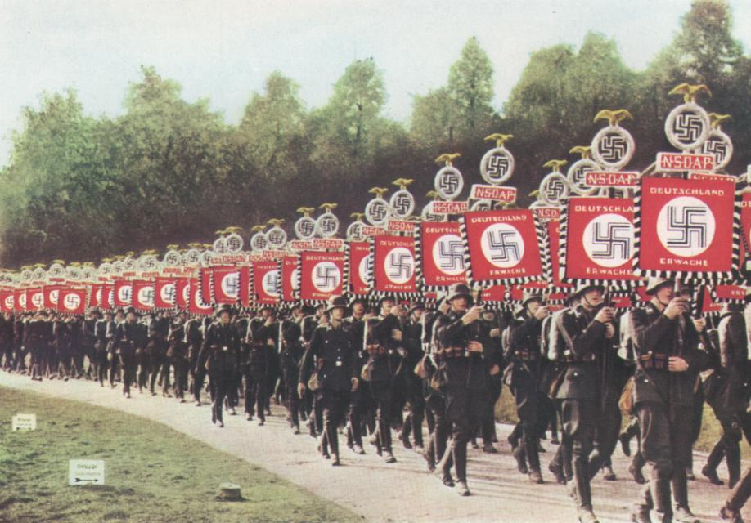
Death of Hindenburg
August 1934
Hitler combines roles of Reich Chancellor and Reich President
Now called “Der Fuhrer”
All soldiers swore a personal oath of loyalty to Hitler

