Slide 1
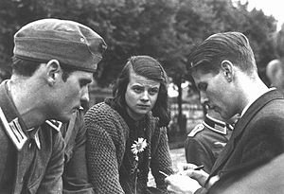
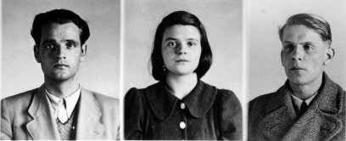
The White Rose group
A small group of students at Munich university, led by siblings Hans (age 24) and Sophie Scholl (21) and Christoph Probst. They disagreed with the Nazis aims and persecution of the Jews. They were disgusted with the lack of opposition and wanted to shame the German people for supporting Hitler.
They were most active between Summer 1942 and February 1943
“Germany’s name will be disgraced forever unless German youth finally rises up, takes revenge, smashes its torturers and builds a new, spiritual Europe” – Sophie Scholl
They spread anti-Nazi messages by handing out leaflets, putting up posters and writing anti-Nazi graffiti on walls
The Nazis branded them as outsiders and enemies of the state. The caretaker saw Hans and Sophie handing out leaflets at Uni and informed the Gestapo. They were arrested and tortured.
22nd February 1943 they were sentenced to death and executed.

Slide 2
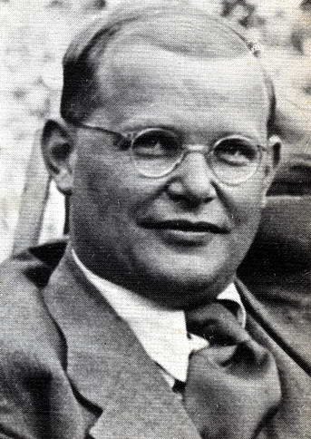
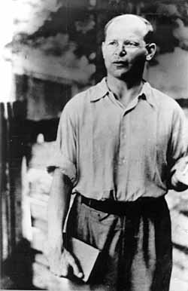
Dietrich Bonhoffer
Bonhoffer trained young men to become Christian ministers. He was against the Nazis from 1933, he pointed out that they were anti-Christian. He opposed their policies on race and euthanasia.
He believed that religion and politics were linked – true religion meant standing up against evil and corrupt governments. When Hitler came to power in 1933 he left Germany to work in London.
However when Niemoller set up the Confessional Church which spoke out against the Nazis in Germany, Bonhoffer returned.
On the outbreak of WW2 in 1939, the Gestapo closed down Bonhoffer's college and banned him from preaching. Over the next few years he continued to work closely with other opponents of Adolf.
In April 1943 Bonhoffer was arrested with his brother Klaus and brother-in-law. He had used his church contacts to help 14 Jews escape to Switzerland and was accused of plotting against Hitler.
He was held in Buchenwald Concentration Camp until being moved to Flossenburg where he was executed in April, 1945

Slide 3
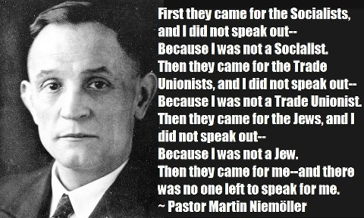
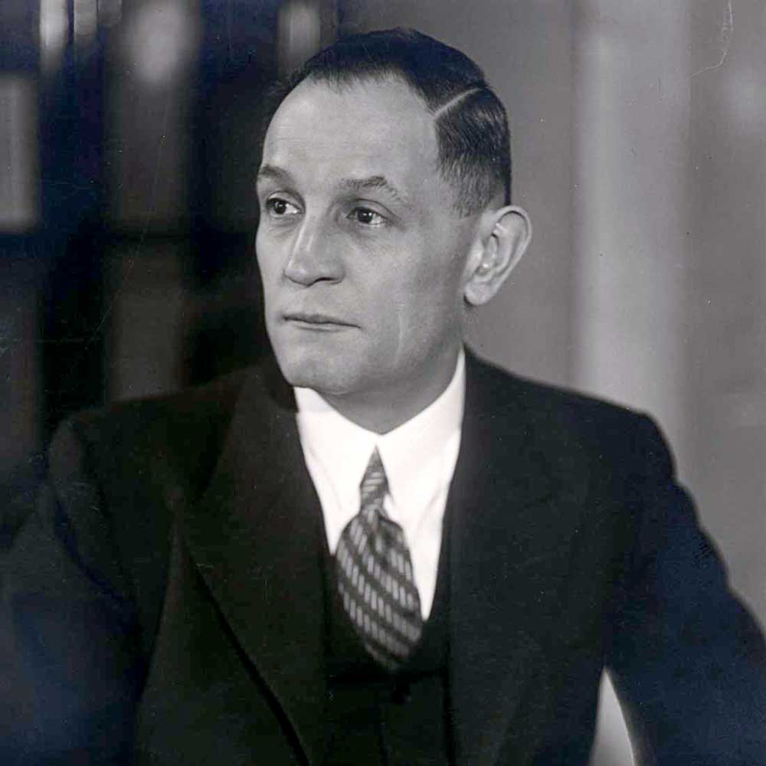
Martin Niemoller
Martin Niemoller was a First World war hero (U-boat captain). He was a right wing supporter, and was even a member of the Freikorps after the war.
He began to openly oppose the Nazis from the 1930s.
Not many Christian ministers opposed the Nazi persecution of the Jews, and only 50 ministers (out of 17,000) were arrested for opposition activities or speeches. Many ministers had sworn an oath of loyalty to the Fuhrer after he set up the Reich church.
Many however, refused. Niemoller helped set up an alternative – the Confessional Church and began to speak out against the Nazis.
In his sermons he spoke out against the arrest of Christian ministers, and the Nazi changes to the Christian church.
He did not however, speak out against Hitler’s political ideas or policies, in fact he admitted that Hitler’s anti-Semitism was a more extreme version of his own prejudices. He was arrested in 1937 and sent to Dachau concentration camp.
He was due to be executed, however he was freed by the Allies shortly before the end of WW2.

Slide 4
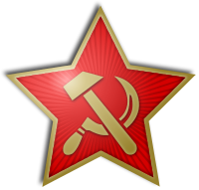
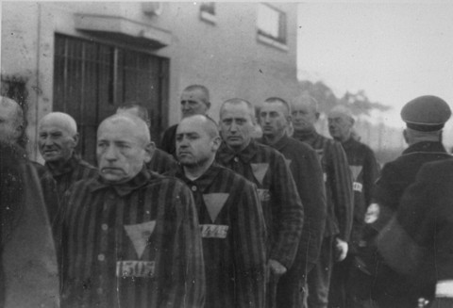
Political Opponents
The main enemies of the Nazi regime were the Socialist Party, the Communist Party and workers’ Trade Unions. They were targeted very early on (after the Reichstag Fire). This was because they had so many supporters . Even when they lost the elections of 1933 they had millions of members.
They wanted workers’ rights. The Socialist Party wanted a return to democracy, the Communists wanted a revolution.
The Nazis banned all these organisations. However members still met in secret – although it was very dangerous because of the risk or arrest. They used passive resistance such as strikes and handing out leaflets. They also write anti-Nazi graffiti on walls.
From 1933 the offices of all political opponents were ransacked by the SA and later the Gestapo. Their offices were closed, and once the Enabling Law was passed, it became illegal to be a member of these groups. Many were beaten up, tortured, some were killed.
There were 400 strikes between 1933 and 1935 but the Gestapo continued to make arrests – two thirds of the Communist Party’s members were arrested.
Many were sent to the Concentration camps, many more went into exile abroad or forced to go underground, holding secret meetings.

Slide 5
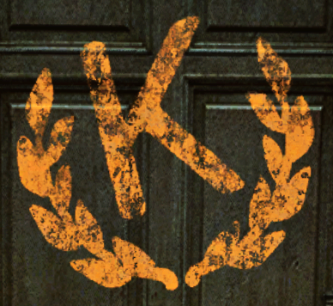
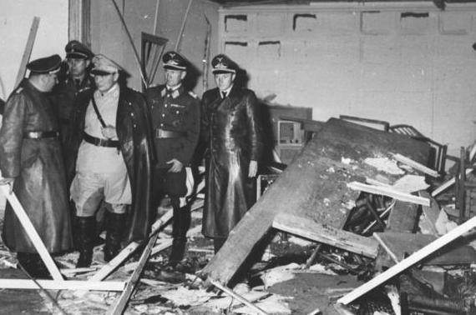
The Kreisau Circle
This group was made up of army generals and intellectuals and officials. Many were members of the Nazi Party – but disliked their policies or became disillusioned with Hitler towards the end of WW2 (1943-45).
Many of them were middle class and disliked Hitler’s working class past. They were also horrified by the actions of the SS death squads in Europe – it went against the army’s code of conduct.
There were said to be dozens of plots to assassinate Hitler – this group in particular had regular access to the Fuhrer. The most famous was the July Bomb plot (known as Operation Valkyrie) – organised by Claus von Stauffenburg, a Colonel who had supported the Nazis to begin with, but was disgusted by their anti-Semitism.
He planted a bomb in Hitler’s military headquarters on a day when he knew Hitler would be there. The bomb exploded and four people were killed, however it failed to kill Hitler because of two main problems – the windows had been left open, lessening the effect of the explosion, and someone had moved the briefcase bomb at the last minute. Despite this, it was the closest anybody had come to killing the Fuhrer.
All the plotters were rounded up and executed.
Hitler also used this as an excuse to get rid of other opponents – 5000 people were arrested and executed as a result of this plot including most members of the Kreisau Circle.

Slide 6
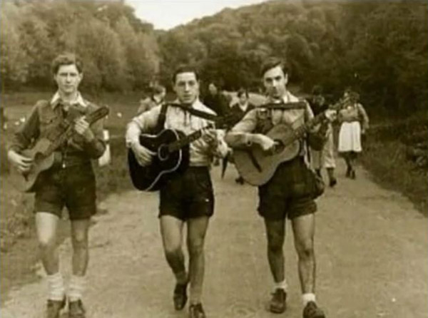
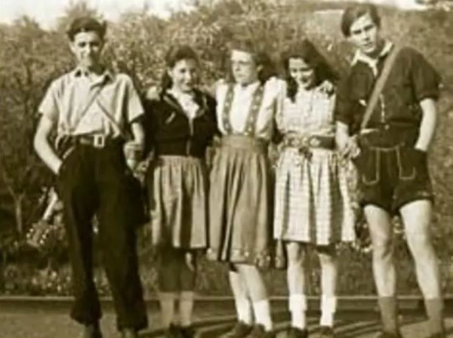
The Edelweiss Pirates
The Edelweiss Pirates was a mostly working class youth group who opposed the Nazi regime.
It wasn’t one big organisation but a collection of groups. Local areas had their versions or branches. Numbers varied, but it was popular and in large cities might have had several hundred members.
They used passive resistance to oppose the Nazis. They refused to join the Hitler Youth, and when this became compulsory they avoided meetings at all costs. They wanted to have fun and do what they wanted – not what they were told.
They engaged in various activities to oppose the Nazis – including making up rude alternatives to the pro-Nazi songs sung by the Hitler Youth, drinking, listening to banned music (‘degenerate jazz and blues’, having sex and going to dances. Some even beat up Nazi Youth members.
Their unofficial uniform was a checked shirt and wearing badges showing the edelweiss flower (a white Alpine flower which became a symbol of resistance for some)
The Gestapo did investigate the groups. Many members of the Edelweiss Pirates were beaten up but punishments were not as severe as for adult opponents. Many had their heads shaved
After a Hitler youth leader in Cologne was killed, some were even hanged in revenge.

